Slide 1
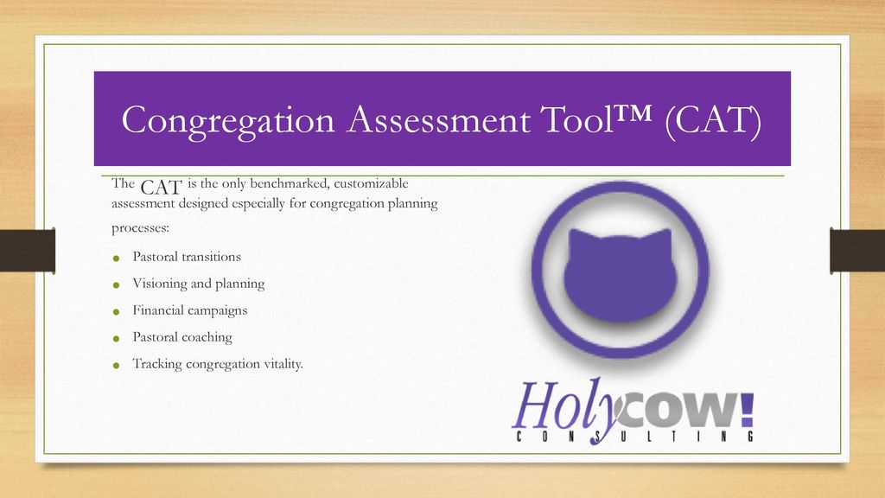
What did the CAT assessment have to say about Christ Lutheran Church? Here are a few of the main findings…

Slide 2
The CAT survey’s purpose was to:
Measure the level of satisfaction and energy in the congregation you lead.
Identify the critical success factors for improving organizational climate.
Pinpoint the strengths of your congregation’s culture.
Discover where members would like to go in the future.
Gauge readiness for change.
Uncover potential resources you may be missing.
  Note: 83 people participated in the survey

Slide 3

One of the key findings
Overall Satisfaction
  Question: “On the whole, I am satisfied with how things are in our church.”
    Clearly agree – 46%
    On the fence – 40%
    Clearly disagree – 14%
  The consultant noted that the “Clearly agree” category was not even 50% and the “Clearly disagree” response of just 14% was significant.
      Something to remember: “Dissatisfaction is a necessary motivating factor for change”.

Slide 4

What do we think of when we think about our “satisfaction” with CLC?
When members are asked how they feel things are going at church overall, they generally don’t think about the entire array of ministries and qualities that characterize the congregation. Instead they focus on a small number of things.
Car analogy
Our pattern of responses suggest that when we think about how satisfied we are with CLC, we tend to focus on the areas on the next slide.

Slide 5
The degree to which we focus on these items is indicated in the column to the right. This column tells us how important the item is to us in determining how satisfied we are.
Our Pastor communicates with people in a way that keeps us informed and connected. | Very High
The worship service at our church is exceptional in both quality and spiritual content. | Very High
Our Pastor articulates a clear vision for our church and keeps it before the people in a compelling way. | Very High
Our Pastor has ensured the development of a plan to care for members in times of need (emotional, mental, physical, spiritual, etc.) | High
Our church provides high quality education that is appropriate to every age and stage of life. | High

Slide 6
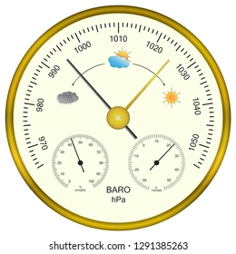
What do we think of when we think about our “excitement” level at CLC? According to the survey, it’s the areas listed below that are important to us in gauging our excitement. It’s not that we are successful at these necessarily, but these are the areas we use as a barometer to measure our excitement.
CLC does a good job helping each member understand that he or she is called to ministry.
CLC provides opportunities for education and formation in a variety of ways so that I can find one that fits my complex lifestyle.
CLC prepares our members for ministry by helping them discern their gifts.
CLC provides high quality education that is appropriate to every age and stage of life.
Our Pastor presides over worship with care, engaging the people in a meaningful way.

Slide 7
The survey indicated we are a “Clergy Focused” congregation. RISK FACTORS for such a congregation include:
Congregation
High anxiety
Loss of commitment to mission
Loss of external focus
Difficulty with pastoral transitions
Periods of perceived absolute harmony and perceived absolute discord dependent of relationship with Pastor
Leaders
High frustration because decision making is often very difficult
Loss of trust
Loss of commitment to mission
Leaders either over-function or under-function, but mutual effort is often absent
Clergy
High anxiety
Burn-out
Loss of energy

Slide 8
The Energy-Satisfaction Map – We scored in the “Low Energy/Low Satisfaction” quadrant. Churches in this quadrant require major changes in order to regain a significant level of vitality and health.
High Energy
Low Satisfaction
High Energy
High Satisfaction
Low Energy
Low Satisfaction
Low Energy
High Satisfaction

Slide 9
When asked where we wanted additional energy placed, these are the top responses.
Make necessary changes to attract families with children and youth
Develop and implement a comprehensive strategy to reach new people and incorporate them into the life of the church.
Provide more opportunities for Christian education and spiritual formation at every age and stage of life.
Create more opportunities for people to form meaningful relationships (for example, small groups, nurtured friendships, shared meals, etc.)
Develop ministries that work toward healing those broken by life circumstances.
Work to renew and revitalize the community around the church by building coalitions with partners.
Strengthen the process by which members are called and equipped for ministry and leadership.

Slide 10
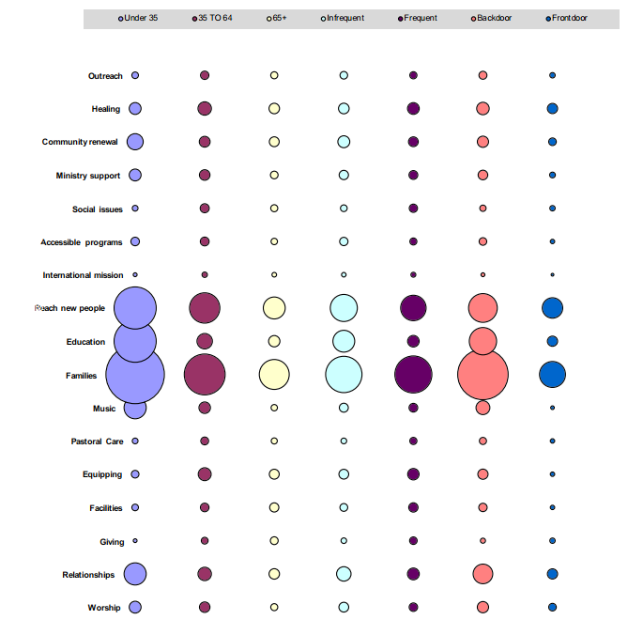

Slide 11

Questions?

