Slide 1

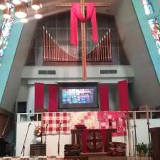
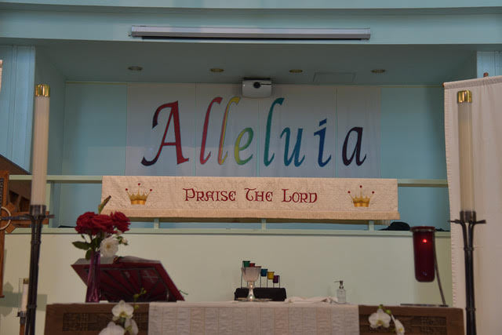
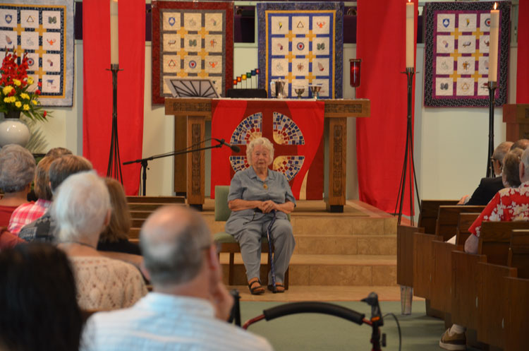
Christ Lutheran
Church
Long Beach, CA
All are welcome and we really mean ALL!
Robyn Strain
Senior Consultant
Holy Cow! Consulting
5/8/2021

Slide 2
SIX FACTORS THAT CHARACTERIZE HEALTHY CONGREGATIONS
VITAL WORSHIP (Inspire, Educate, Challenge)
ADAPTABILITY
MEANINGFUL RELATIONSHIPS (Affinity, Authenticity, Accountability)
OPEN DECISION MAKING PROCESS AND REPRESENTATIVE GOVERNANCE
LIFELONG LEARNING ORIENTATION
EDUCATION AND FORMATION FOR COMPLEX LIFESTYLES

Slide 3
On the whole, I am satisfied with how things are in our church.
Clearly agree 46%
On the fence 40%
Clearly disagree 14%
Low average

Slide 4
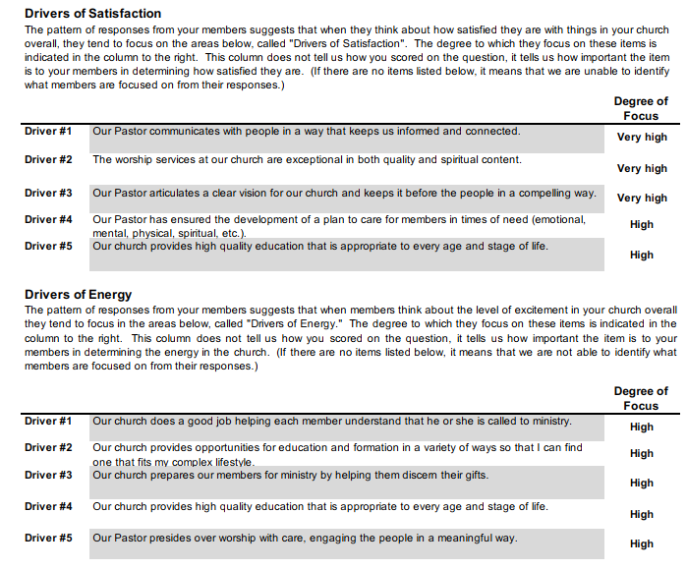
=focus on clergy
=focus on education/formation
=focus on readiness for ministry
DRIVERS

Slide 5
RISK FACTORS
Congregation
High anxiety
Loss of commitment to mission
Loss of external focus
Difficulty with pastoral transitions
Periods of perceived absolute harmony and perceived absolute discord dependent of relationship with Pastor
Leaders
High frustration because decision making is often very difficult
Loss of trust
Loss of commitment to mission
Leaders either over-function or under-function, but mutual effort is often absent
Clergy
High anxiety
Burn-out
Loss of energy

Slide 6
High Energy
High Energy
Low Satisfaction
Chaos
Transformational
Low Satisfaction
High Satisfaction
Low Energy
Low Satisfaction
Low Energy
High Satisfaction
Low Energy

Slide 7
Dissatisfaction is a Necessary
Motivating Factor for Change
We as humans do not typically change
things we are satisfied with

Slide 8
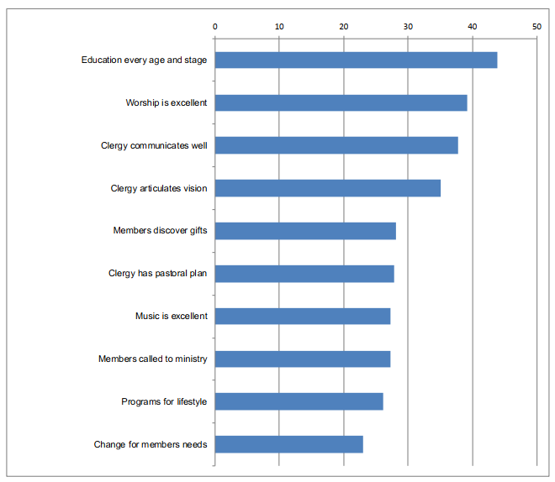

CRITICAL SUCCESS FACTORS
These are important to most people.
Most believe improvement is needed.
=focus on clergy
=focus on education/formation
=focus on readiness for ministry

Slide 9
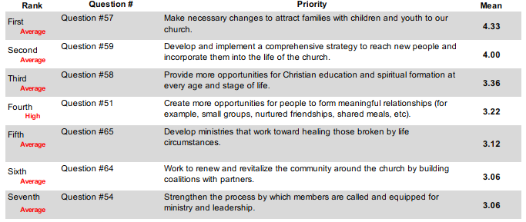
PRIORITIES FOR THE FUTURE

Slide 10

Unusual priorities FOR THE FUTURE

Slide 11
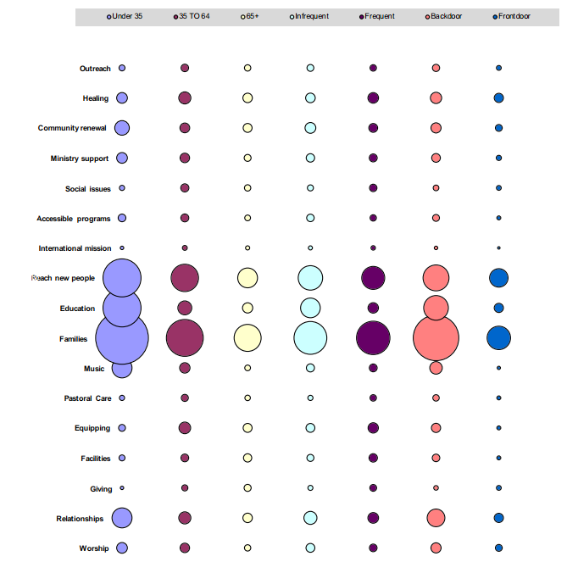
The bubble chart

Slide 12
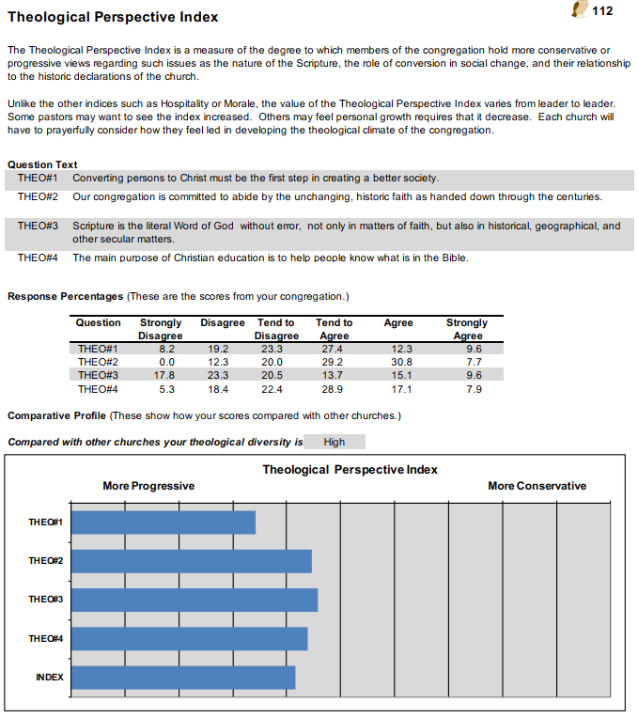

Slide 13


Descriptive Map
Adaptable
MAGI
PERFORMANCE
MAGI
PERFORMANCE
Progressive
Conservative
PARACLETE
HEARTH & HOME
HEARTH
AND HOME
PARACLETE
Settled
113

Slide 14
MAGI Culture
Theologically “PROGRESSIVE” and adaptable
Ultimately concerned with the rational integrity of faith and just application of faith to life.
Values deep knowledge, open discourse and intellectual curiosity; frequently exhibits a penetrating analytic culture.
Not averse to wandering aspect of faith
Capacity to be a powerful ally for those with minority status or who lack power to protect themselves.
Capable of embracing meaningful changes necessary to engage a
changing society.
May need to overcome the temptation to overthink issues or try to be everything to everyone.
Since care for others is often expressed in terms of fairness and justice, may need to develop a deeper relational component to prevent being misperceived as unapproachable, impersonal or uncaring.
Dominant reflexes often prioritized around rational understanding which may not give proper weight to role of emotion in persuading and enlisting support (Internally low hospitality scores do not necessarily impact people’s views on the church overall.)
In quest to be open, may not give enough voice to values of
commitment and clarity
Larger issues may detract from need to develop interpersonal skills, conflict resolution skills, and trust.

Slide 15
Performance Culture
Theologically “conservative” and adaptable
Ultimately concerned with faith presented in a way that people find accessible and compelling, often resulting in powerful experiences for participants that open them to alternative ways of looking at life.
Serves as bridge between traditional understandings of Christian beliefs and contemporary life experiences
Concerned with what works now, not by changing basic message but by discovering ways to increase impact of that message to connect faith to life
Maintains strong missional focus to prevent chasing a religious high where change does not have adequate roots to be sustainable
Balances focus on conversion and transformation with understanding that spiritual development and recovery can often be slow and painful
Identifying and developing the gifts of clergy and lay leaders, opportunities to utilize their gifts, and support to them in their ministry is likely to be worth the time and energy given the need for creative resources
At their best, members of the church are fun loving and lively and avoid the temptation to be judgmental
Service to others, spiritual discipline, and clear missional focus are important to maximize vitality

Slide 16
PARACLETE Culture
Theologically “PROGRESSIVE” and SETTLED
Ultimately concerned with balancing an intellectually open and reflective faith community with structure and practices that provide external stability for those seeking to develop and grow
At their best, this is accomplished through openness to those with different theological perspectives and spiritual practices
Tend to be less demanding of a particular understanding of faith, but clearer about the benefits of a particular liturgical tradition
When the community is warm and hospitable, it has the potential to be a haven for those in need of healing or recovery
In a compassionate response to suffering, may focus on ministries of healing and develop counseling centers, food pantries, homeless shelters, spiritual direction, support groups, and recovery services-often engaged in the front-line work of these ministries
Must balance the admirable tendency to accept people where they are with an adequate level of accountability that is also essential to wholeness and practice of core values
There is often an emphasis on the power of the Gospel to transform, not simply comfort
May need to overcome the temptation to overcommit to meeting the needs of others which often results in burnout
Missional focus prevents work from devolving into just going through the motions of set activities and loss of a sense of deeper meaning
Avoid a cycle of well-intentioned activity where freedom of thought or individual pain becomes an excuse for mediocrity. Focus on excellence!

Slide 17
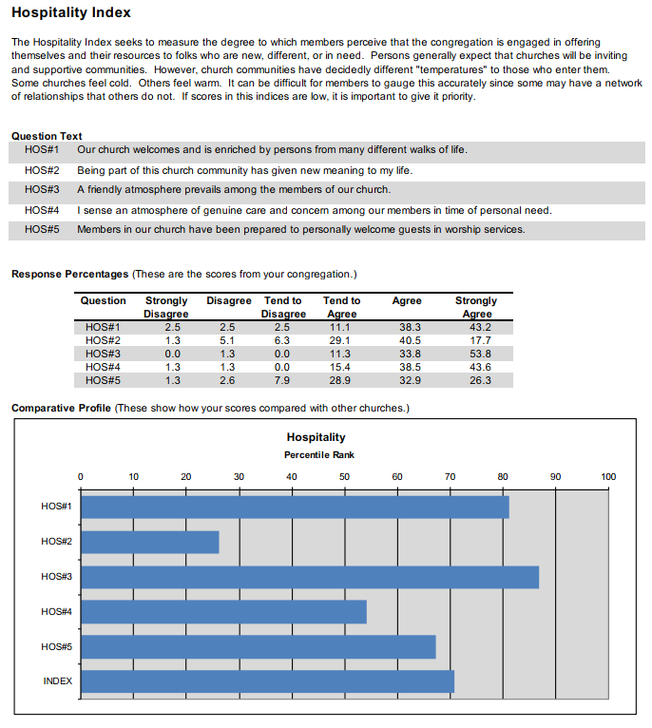

Slide 18
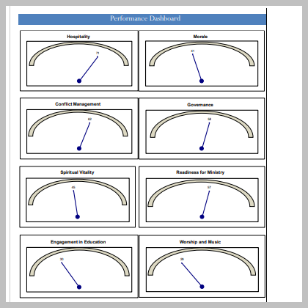

Slide 19
Promise #1
We will create a church where worship experiences are exceptional in their ability to inspire, engage and enrich our spiritual lives.

Slide 20
Promise #2
We will create a church experience where involvement is good for the soul instead of leading to disillusionment or disappointment.

Slide 21
Promise #3
We will create a church experience where every person understands the significance of his or her life in the universe and is supported in fulfilling the purpose for which they were born.

Slide 22
Promise #4
We will create a church experience where people live in peace with one another by resolving conflict in ways that are respectful and restorative.

Slide 23
Promise #5
We will create a church where persons experience leaders who listen deeply with open hearts and make courageous decisions with good intentions.

Slide 24
“Americans want a spirituality that is relevant, that changes people, and that really makes a difference in this world.”
Richard Rohr

